Slide 1
CS 152 Computer Architecture and Engineering CS252 Graduate Computer Architecture Lecture 15 – Vectors
Krste Asanovic
Electrical Engineering and Computer Sciences
University of California at Berkeley
http://www.eecs.berkeley.edu/~krste
http://inst.eecs.berkeley.edu/~cs152

Slide 2
Last Time Lecture 14: Multithreading
Simultaneous
Multithreading
Time (processor cycle)
Superscalar
Fine-Grained
Coarse-Grained
Multiprocessing
Thread 1
Thread 3
Thread 5
Thread 2
Thread 4
Idle slot

Slide 3
Supercomputer Applications
Typical application areas
Military research (nuclear weapons, cryptography)
Scientific research
Weather forecasting
Oil exploration
Industrial design (car crash simulation)
Bioinformatics
Cryptography
All involve huge computations on large data set
Supercomputers: CDC6600, CDC7600, Cray-1, …
In 70s-80s, Supercomputer ≡ Vector Machine

Slide 4
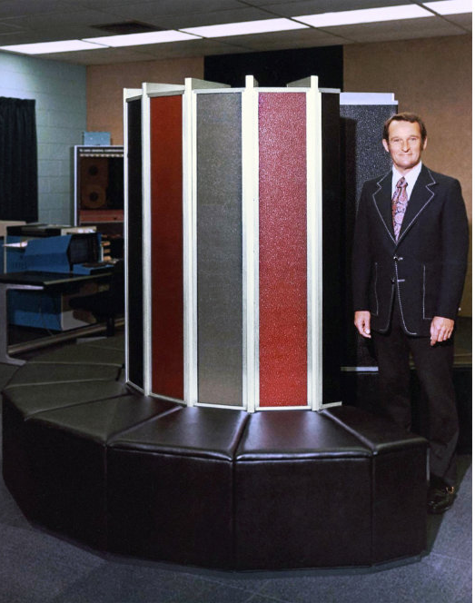
Vector Supercomputers
Epitomized by Cray-1, 1976:
Scalar Unit
Load/Store Architecture
Vector Extension
Vector Registers
Vector Instructions
Implementation
Hardwired Control
Highly Pipelined Functional Units
Interleaved Memory System
No Data Caches
No Virtual Memory
[©Cray Research, 1976]

Slide 5
Vector Programming Model
Scalar Registers
Vector Registers
x31
v31
x0
v0
[0]
[1]
[2]
[VLMAX-1]
Vector Length Register
vl
v1
Vector Arithmetic Instructions
vadd v3,v1,v2
v2
+
+
+
+
+
+
v3
[0]
[1]
[vl-1]
Vector Load and Store Instructions
vls v1,(x1),x2
Vector Register
v1
Memory
Base, x1
Stride, x2

Slide 6
Vector Code Example
# C code
for (i=0; i<64; i++)
C[i] = A[i] + B[i];
# Vector Code
li x4, 64
vsetvl x4
vld v1, (x1)
vld v2, (x2)
vadd v3,v1,v2
vst v3, (x3)
# Scalar Code
li x4, 64
loop:
fld f1, 0(x1)
fld f2, 0(x2)
fadd.d f3,f1,f2
fsd f3, 0(x3)
addi x1, x1, 8
addi x2, x2, 8
addi x3, x3, 8
subi x4, x4, 1
bnez x4, loop

Slide 7
Cray-1 (1976)
V0
V_{i}
V. Mask
V1
V_{j}
64 Element Vector Registers
V2
V. Length
V3
V_{k}
Single-Port
Memory
16 banks of 64-bit words
+
8-bit SECDED
80MW/sec data load/store
320MW/sec instruction
buffer refill
V4
V5
V6
V7
FP Add
S0
S_{j}
FP Mul
( (A_{h}) + j k m )
S1
S2
S_{k}
FP Recip
64
T Regs
S_{i}
S3
(A₀)
S4
S_{i}
Int Add
T_{jk}
S5
S6
Int Logic
S7
Int Shift
( (A_{h}) + j k m )
A0
Pop Cnt
A1
A_{i}
A2
A_{j}
(A₀)
64
B Regs
A3
A_{k}
Addr Add
B_{jk}
A4
A5
A_{i}
Addr Mul
A6
A7
64-bitx16
NIP
CIP
4 Instruction Buffers
LIP
memory bank cycle 50 ns processor cycle 12.5 ns (80MHz)

Slide 8
Vector Instruction Set Advantages
Compact
one short instruction encodes N operations
Expressive, tells hardware that these N operations:
are independent
use the same functional unit
access disjoint registers
access registers in same pattern as previous instructions
access a contiguous block of memory (unit-stride load/store)
access memory in a known pattern (strided load/store)
Scalable
can run same code on more parallel pipelines (lanes)

Slide 9
Vector Arithmetic Execution
Use deep pipeline (=> fast clock) to execute element operations
Simplifies control of deep pipeline because elements in vector are independent (=> no hazards!)
v1
v2
v3
Six-stage multiply pipeline
v3 <- v1 * v2

Slide 10
Vector Instruction Execution
vadd vc, va, vb
Execution using one pipelined functional unit
Execution using four pipelined functional units
A[6]
B[6]
A[24]
B[24]
A[25]
B[25]
A[26]
B[26]
A[27]
B[27]
A[5]
B[5]
A[20]
B[20]
A[21]
B[21]
A[22]
B[22]
A[23]
B[23]
A[4]
B[4]
A[16]
B[16]
A[17]
B[17]
A[18]
B[18]
A[19]
B[19]
A[3]
B[3]
A[12]
B[12]
A[13]
B[13]
A[14]
B[14]
A[15]
B[15]
C[2]
C[8]
C[9]
C[10]
C[11]
C[1]
C[4]
C[5]
C[6]
C[7]
C[0]
C[0]
C[1]
C[2]
C[3]

Slide 11
Interleaved Vector Memory System
Bank busy time: Time before bank ready to accept next request
Cray-1, 16 banks, 4 cycle bank busy time, 12 cycle latency
Base
Stride
Vector Registers
Address Generator
+
0
1
2
3
4
5
6
7
8
9
A
B
C
D
E
F
Memory Banks

Slide 12
Vector Unit Structure
Functional Unit
Vector
Registers
Elements 0, 4, 8, …
Elements 1, 5, 9, …
Elements 2, 6, 10, …
Elements 3, 7, 11, …
Lane
Memory Subsystem

Slide 13
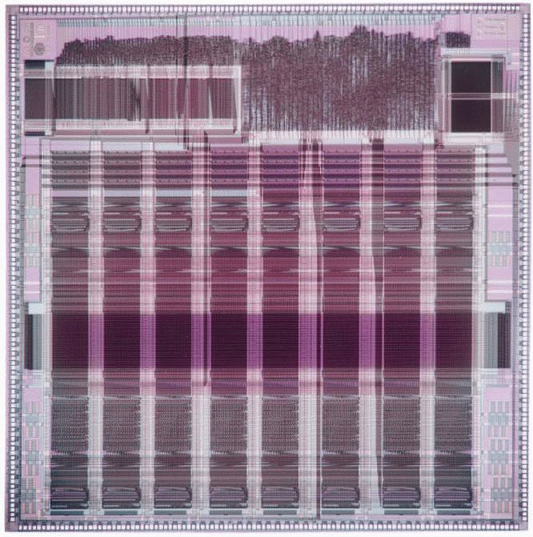
T0 Vector Microprocessor (UCB/ICSI, 1995)
Vector register elements striped over lanes
Lane
[24]
[25]
[26]
[27]
[28]
[29]
[30]
[31]
[16]
[17]
[18]
[19]
[20]
[21]
[22]
[23]
[8]
[9]
[10]
[11]
[12]
[13]
[14]
[15]
[0]
[1]
[2]
[3]
[4]
[5]
[6]
[7]

Slide 14
Vector Instruction Parallelism
Can overlap execution of multiple vector instructions
example machine has 32 elements per vector register and 8 lanes
Load Unit
Multiply Unit
Add Unit
load
mul
add
time
load
mul
add
Instruction issue
Complete 24 operations/cycle while issuing 1 short instruction/cycle

Slide 15
Vector Chaining
Vector version of register bypassing
introduced with Cray-1
vld v1
vmul v3,v1,v2
vadd v5, v3,v4
V1
V2
V3
V4
V5
Chain
Chain
Load Unit
Mult.
Add
Memory

Slide 16
Vector Chaining Advantage
Without chaining, must wait for last element of result to be written before starting dependent instruction
Load
Mul
Time
Add
With chaining, can start dependent instruction as soon as first result appears
Load
Mul
Add

Slide 17
Vector Startup
Two components of vector startup penalty
functional unit latency (time through pipeline)
dead time or recovery time (time before another vector instruction can start down pipeline)
Functional Unit Latency
R
X
X
X
W
First Vector Instruction
R
X
X
X
W
R
X
X
X
W
R
X
X
X
W
R
X
X
X
W
Dead Time
R
X
X
X
W
R
X
X
X
W
R
X
X
X
W
Second Vector Instruction
Dead Time
R
X
X
X
W
R
X
X
X
W

Slide 18
Dead Time and Short Vectors
No dead time
4 cycles dead time
T0, Eight lanes
No dead time
100% efficiency with 8-element vectors
64 cycles active
Cray C90, Two lanes
4-cycle dead time
Maximum efficiency 94% with 128-element vectors

Slide 19
Vector Memory-Memory versus Vector Register Machines
Vector memory-memory instructions hold all vector operands in main memory
The first vector machines, CDC Star-100 (‘73) and TI ASC (‘71), were memory-memory machines
Cray-1 (’76) was first vector register machine
Vector Memory-Memory Code
Example Source Code
vadd (C),(A),(B)
vsub (D),(A),(B)
for (i=0; i<N; i++)
{
C[i] = A[i] + B[i];
D[i] = A[i] - B[i];
}
Vector Register Code
vld V1, (A)
vld V2, (B)
vadd V3, V1, V2
vst V3, (C)
vsub V4, V1, V2
vst V4, (D)

Slide 20
Vector Memory-Memory vs. Vector Register Machines
Vector memory-memory architectures (VMMA) require greater main memory bandwidth, why?
All operands must be read in and out of memory
VMMAs make if difficult to overlap execution of multiple vector operations, why?
Must check dependencies on memory addresses
VMMAs incur greater startup latency
Scalar code was faster on CDC Star-100 for vectors < 100 elements
For Cray-1, vector/scalar breakeven point was around 2-4 elements
Apart from CDC follow-ons (Cyber-205, ETA-10) all major vector machines since Cray-1 have had vector register architectures
(we ignore vector memory-memory from now on)

Slide 21
CS152 Administrivia
PS 4 out today, due Monday April 5
Lab 3 due Monday April 5
No lectures or sections next week!
Spring Break (March 22-26)

Slide 22
CS252 Administrivia
Readings on OoO architectures this Thursday

Slide 23
Automatic Code Vectorization
for (i=0; i < N; i++)
C[i] = A[i] + B[i];
Scalar Sequential Code
Vectorized Code
load
load
load
Iter. 1
load
load
load
Time
add
add
add
store
store
store
load
Iter. 1
Iter. 2
Iter. 2
load
Vector Instruction
Vectorization is a massive compile-time reordering of operation sequencing
requires extensive loop-dependence analysis
add
store

Slide 24
Vector Stripmining
Problem: Vector registers have finite length
Solution: Break loops into pieces that fit in registers, “Stripmining”
andi x1, xN, 63 # N mod 64
vsetvl x1 # Do remainder
loop:
vld v1, (xA)
slli x2, x1, 3 # Multiply by 8
add xA, xA, x2 # Bump pointer
vld v2, (xB)
add xB, xB, x2
vadd v3, v1, v2
vst v3, (xC)
add xC, xC, x2
sub xN, xN, x1 # Subtract elements
li x1, 64
vsetvl x1 # Reset full length
bgtz xN, loop # Any more to do?
for (i=0; i<N; i++)
C[i] = A[i]+B[i];
A
B
C
+
Remainder
+
64 elements
+

Slide 25
Vector Conditional Execution
Problem: Want to vectorize loops with conditional code:
for (i=0; i<N; i++)
if (A[i]>0) then
A[i] = B[i];
Solution: Add vector mask (or flag) registers
vector version of predicate registers, 1 bit per element
…and maskable vector instructions
vector operation becomes bubble (“NOP”) at elements where mask bit is clear
Code example:
cvm # Turn on all elements
vld vA, (xA) # Load entire A vector
vgt vA, f0 # Set bits in mask register where A>0
vld vA, (xB) # Load B vector into A under mask
vst vA, (xA) # Store A back to memory under mask

Slide 26
Masked Vector Instructions
Simple Implementation
execute all N operations, turn off result writeback according to mask
Density-Time Implementation
scan mask vector and only execute elements with non-zero masks
M[7]=1
A[7]
B[7]
M[7]=1
M[6]=0
A[6]
B[6]
M[6]=0
A[7]
B[7]
M[5]=1
A[5]
B[5]
M[5]=1
M[4]=1
A[4]
B[4]
M[4]=1
M[3]=0
A[3]
B[3]
M[3]=0
C[5]
M[2]=0
C[4]
M[1]=1
M[2]=0
C[2]
M[0]=0
M[1]=1
C[1]
C[1]
Write data port
M[0]=0
C[0]
Write Enable
Write data port

Slide 27
Compress/Expand Operations
Compress packs non-masked elements from one vector register contiguously at start of destination vector register
population count of mask vector gives packed vector length
Expand performs inverse operation
M[7]=1
A[7]
A[7]
A[7]
M[7]=1
M[6]=0
A[6]
A[5]
B[6]
M[6]=0
M[5]=1
A[5]
A[4]
A[5]
M[5]=1
M[4]=1
A[4]
A[1]
A[4]
M[4]=1
M[3]=0
A[3]
A[7]
B[3]
M[3]=0
M[2]=0
A[2]
A[5]
B[2]
M[2]=0
M[1]=1
A[1]
A[4]
A[1]
M[1]=1
M[0]=0
A[0]
A[1]
B[0]
M[0]=0
Compress
Expand
Used for density-time conditionals and also for general selection operations

Slide 28
Vector Reductions
Problem: Loop-carried dependence on reduction variables
sum = 0;
for (i=0; i<N; i++)
sum += A[i]; # Loop-carried dependence on sum
Solution: Re-associate operations if possible, use binary tree to perform reduction
# Rearrange as:
sum[0:VL-1] = 0 # Vector of VL partial sums
for(i=0; i<N; i+=VL) # Stripmine VL-sized chunks
sum[0:VL-1] += A[i:i+VL-1]; # Vector sum
# Now have VL partial sums in one vector register
do {
VL = VL/2; # Halve vector length
sum[0:VL-1] += sum[VL:2*VL-1] # Halve no. partials
} while (VL>1)

Slide 29
Vector Scatter/Gather
Want to vectorize loops with indirect accesses:
for (i=0; i<N; i++)
A[i] = B[i] + C[D[i]]
Indexed load instruction (Gather)
vld vD, (xD) # Load indices in D vector
vlx vC, (xC), vD # Load indexed from xC base
vld vB, (xB) # Load B vector
vadd vA,vB,vC # Do add
vst vA, (xA) # Store result

Slide 30
Histogram with Scatter/Gather
Histogram example:
for (i=0; i<N; i++)
A[B[i]]++;
Is following a correct translation?
vld vB, (xB) # Load indices in B vector
vlx vA, (xA), vB # Gather initial A values
vadd vA, vA, 1 # Increment
vsx vA, (xA), vB # Scatter incremented values

Slide 31
Vector Memory Models
Some vector machines have a very relaxed memory model, e.g.
vst v1, (x1) # Store vector to x1
vld v2, (x1) # Load vector from x1
No guarantee that elements of v2 will have value of elements of v1 even when store and load execute by same processor!
So require explicit memory barrier or fence
vst v1, (x1) # Store vector to x1
fence # Enforce ordering s->l
vld v2, (x1) # Load vector from x1
Vector machines support highly parallel memory systems (multiple lanes and multiple load and store units) with long latency (100+ clock cycles)
hardware coherence checks would be prohibitively expensive
vectorizing compiler can eliminate most dependencies

Slide 32
Packed SIMD Extensions
64b
32b
32b
16b
16b
16b
16b
8b
8b
8b
8b
8b
8b
8b
8b
Very short vectors added to existing ISAs for microprocessors
Use existing 64-bit registers split into 2x32b or 4x16b or 8x8b
Lincoln Labs TX-2 from 1957 had 36b datapath split into 2x18b or 4x9b
Newer designs have wider registers
128b for PowerPC Altivec, Intel SSE2/3/4
256b/512b for Intel AVX
Single instruction operates on all elements within register
16b
16b
16b
16b
16b
16b
16b
16b
4x16b adds
+
+
+
+
16b
16b
16b
16b

Slide 33
Packed SIMD versus Vectors
Limited instruction set:
no vector length control
no strided load/store or scatter/gather
unit-stride loads must be aligned to 64/128-bit boundary
Limited vector register length:
requires superscalar dispatch to keep multiply/add/load units busy
loop unrolling to hide latencies increases register pressure
Trend towards fuller vector support in microprocessors
Better support for misaligned memory accesses
Support of double-precision (64-bit floating-point)
New Intel AVX spec (announced April 2008), 256b vector registers (expandable up to 1024b), gather added, scatter to follow
ARM Scalable Vector Extensions (SVE)

Slide 34
Acknowledgements
This course is partly inspired by previous MIT 6.823 and Berkeley CS252 computer architecture courses created by my collaborators and colleagues:
Arvind (MIT)
Joel Emer (Intel/MIT)
James Hoe (CMU)
John Kubiatowicz (UCB)
David Patterson (UCB)

